Slide 1
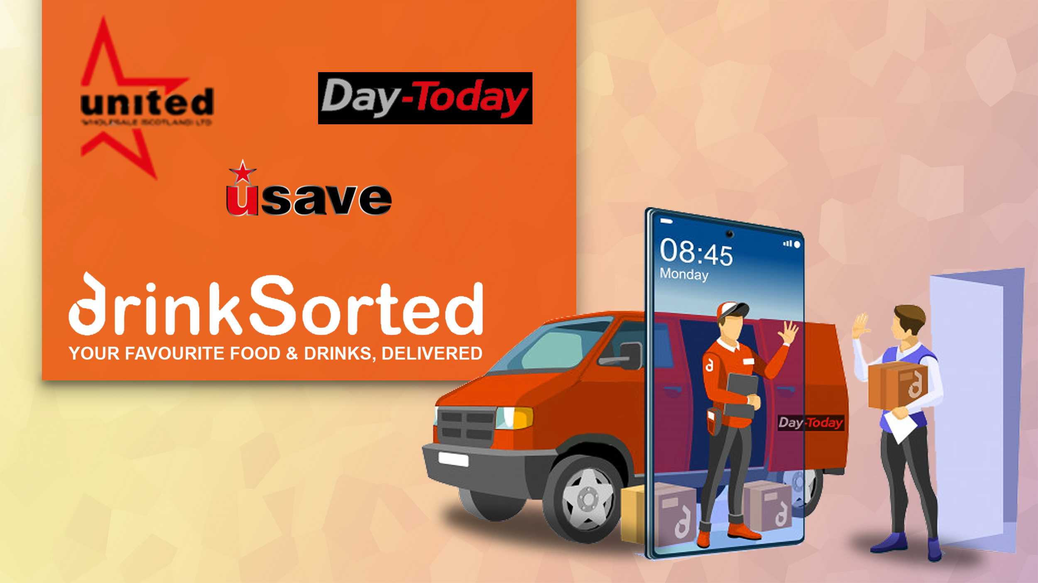

Slide 2

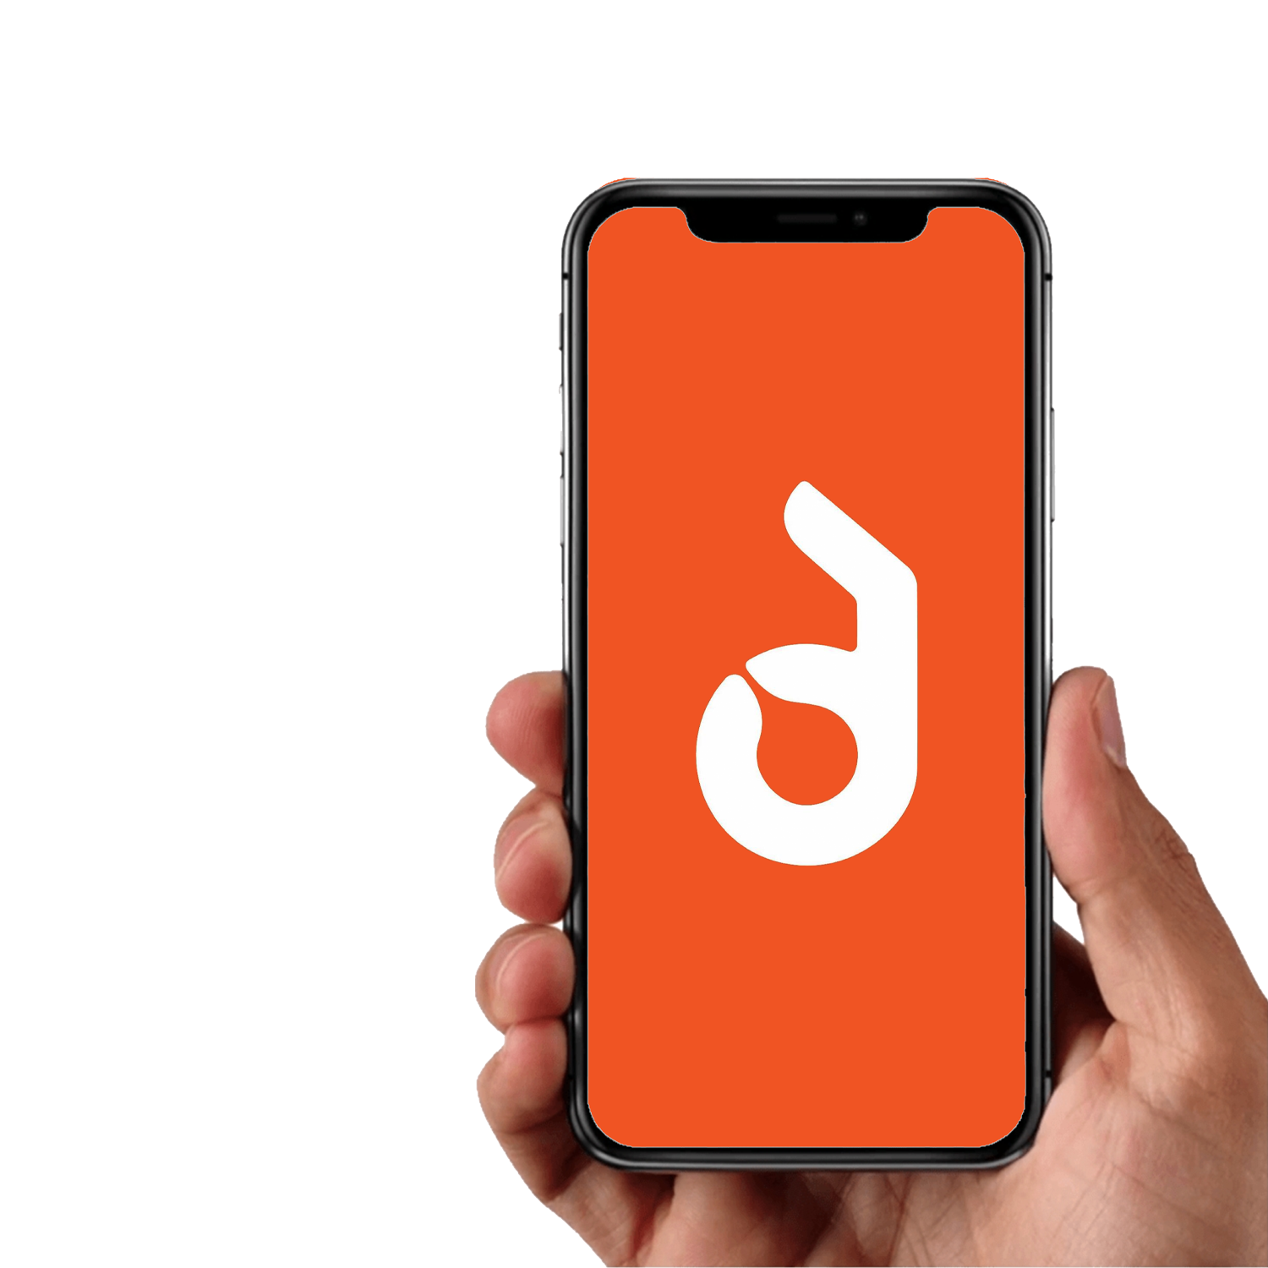
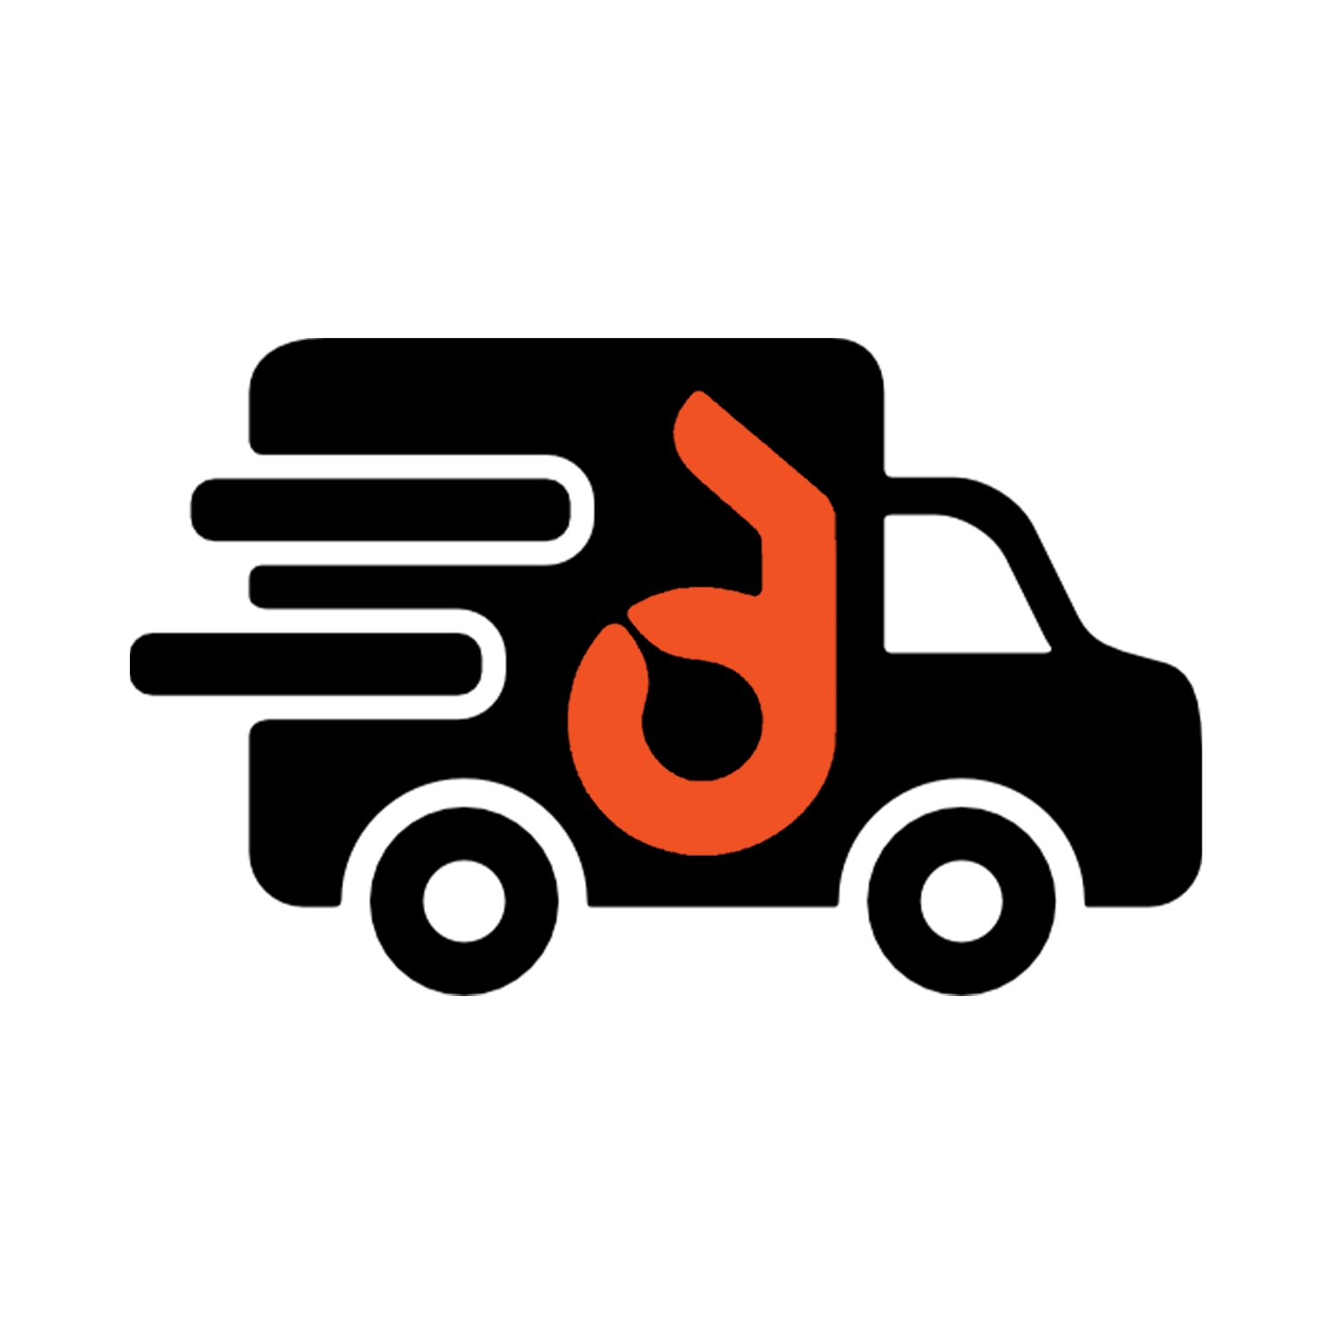
What is ?
is a proven Home Delivery Platform for the Convenience Sector.
The platform offers three mobile phone apps:
one for consumers; one for delivery drivers; and one for retailers.
Allows the retailer to seamlessly compete with mainstream.
The retailer can maintain full margin without increasing prices.
They will also get full control over instant pricing and offers.

Slide 3


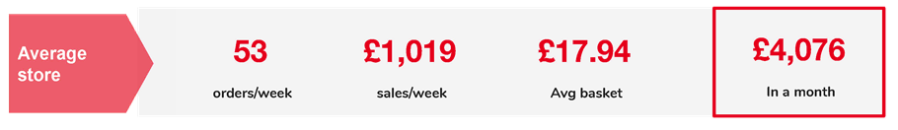
60% of UK population order food delivery each month.
Delivery has grown 5x more than the total Eating Out market between 2015-20.
Brits spend £4.2 billion per year on food delivery.
£25k a month online sales for top performing store.
Even the slowest performing store can make £4k a month.

Slide 4

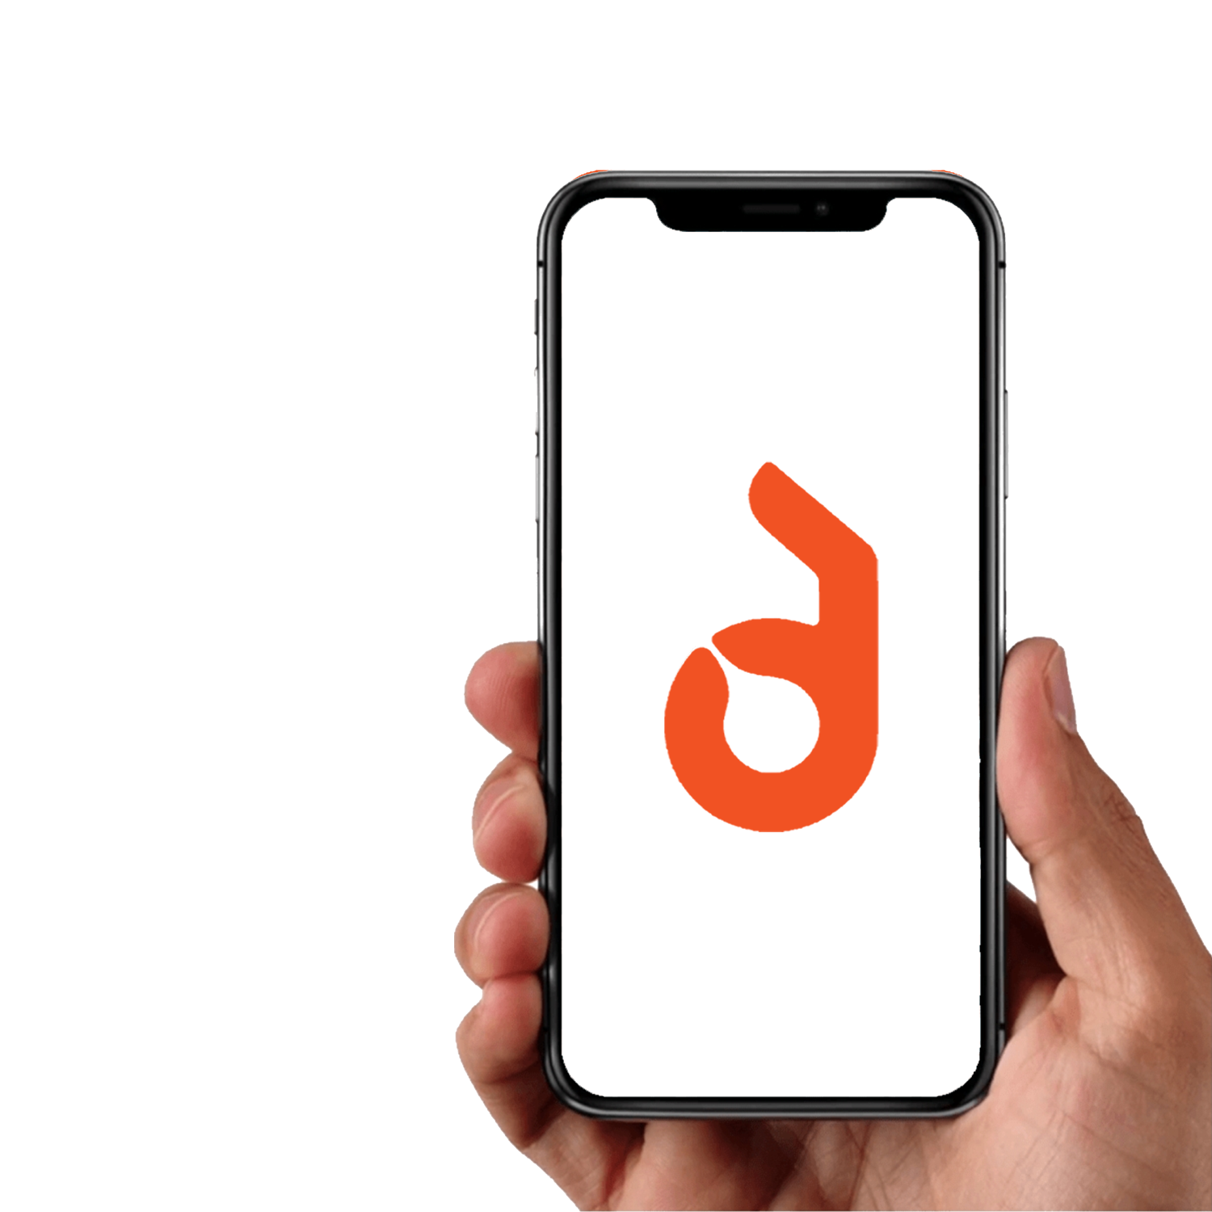



LOW COST SETUP OF £200
NO TIER CHARGING
ONLY 2.99% COMMISSION
NO SURCHARGE FOR CONSUMERS
KEY FEATURES
EASY TO USE
APP BASED PLATFORM
24 HOUR TECH / NON TECH SUPPORT.

Slide 5



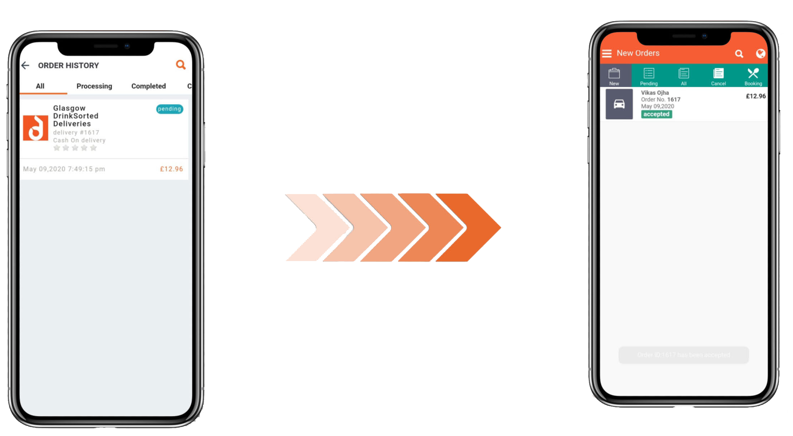
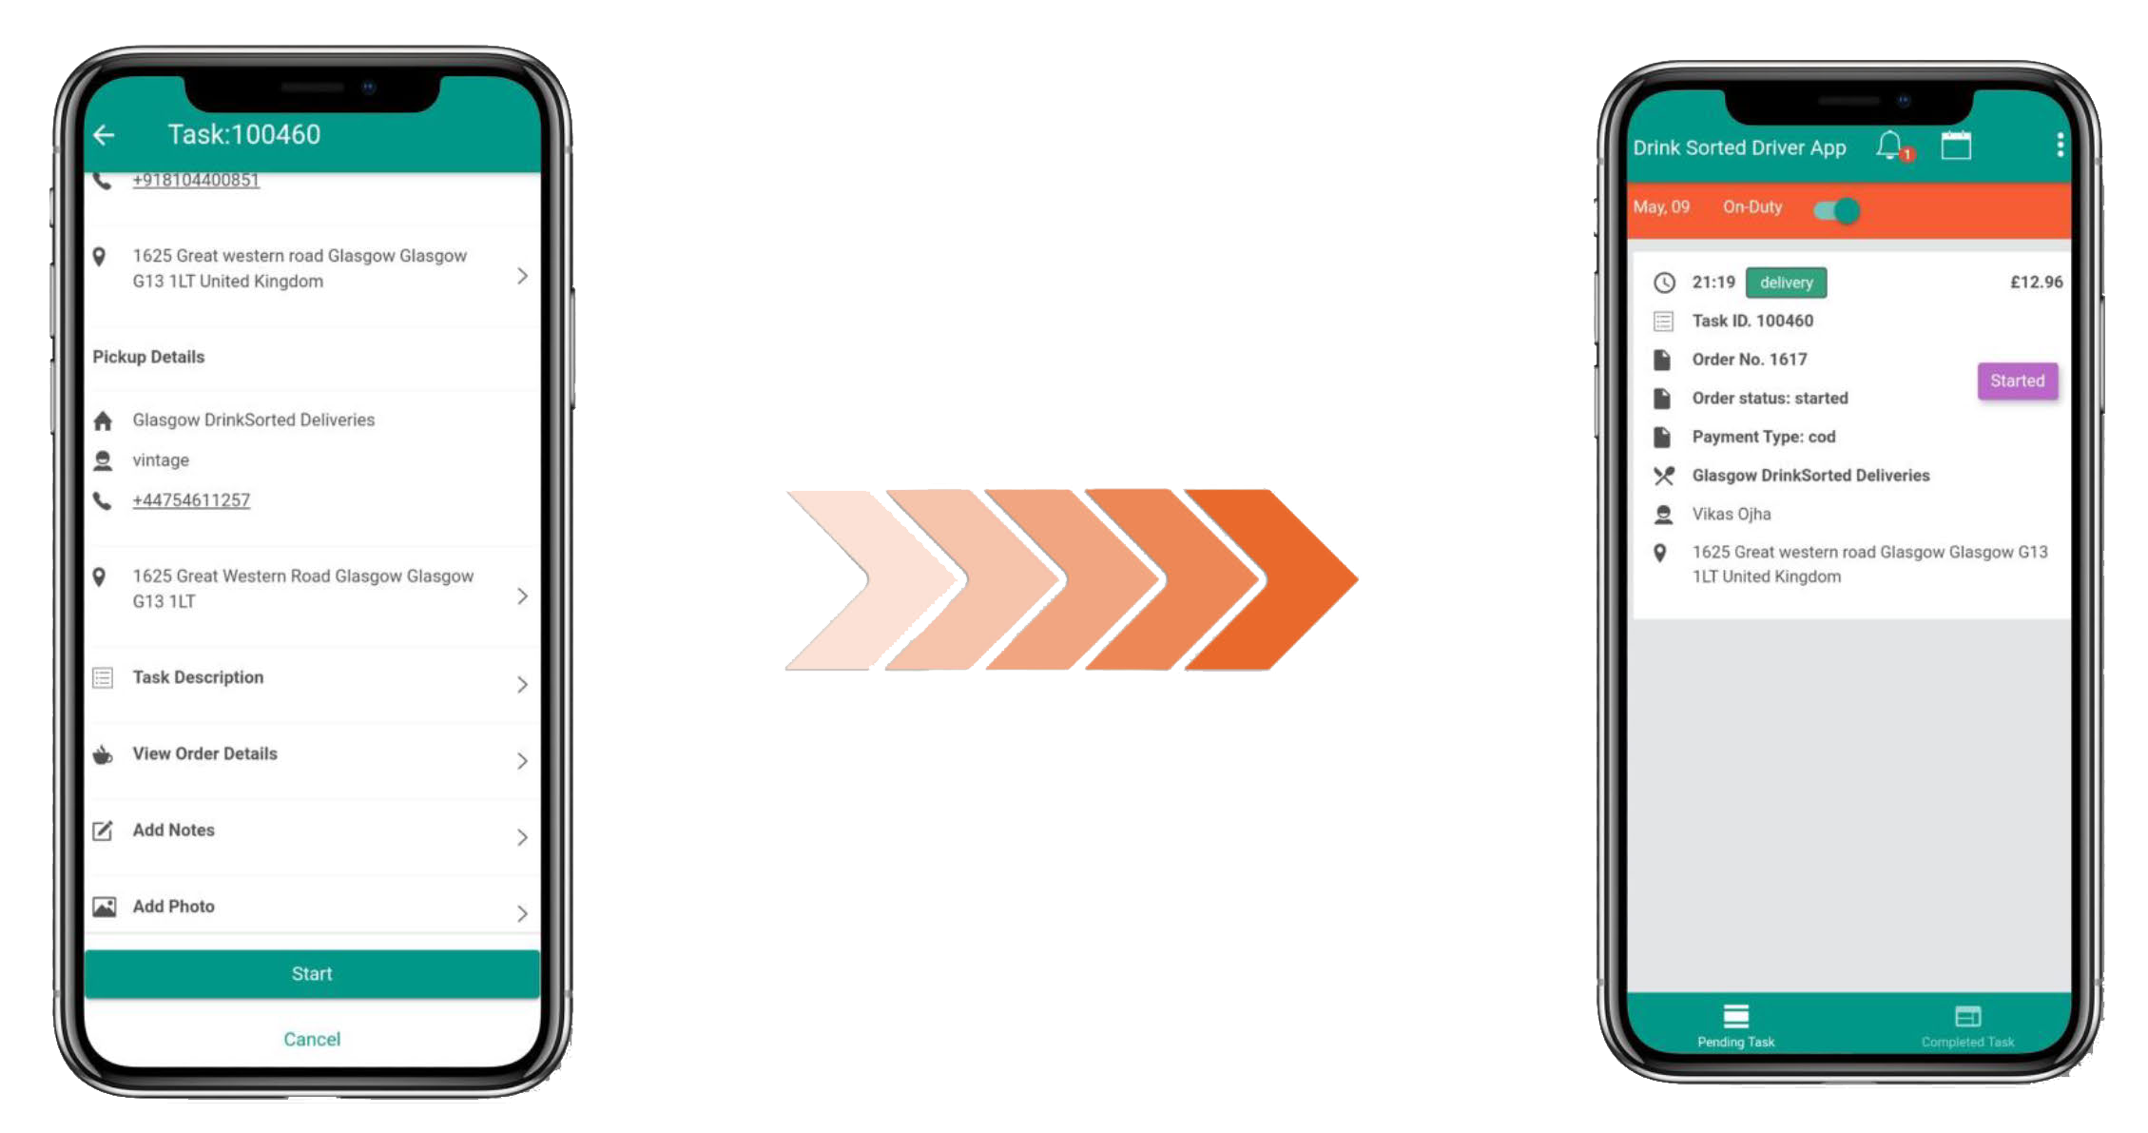
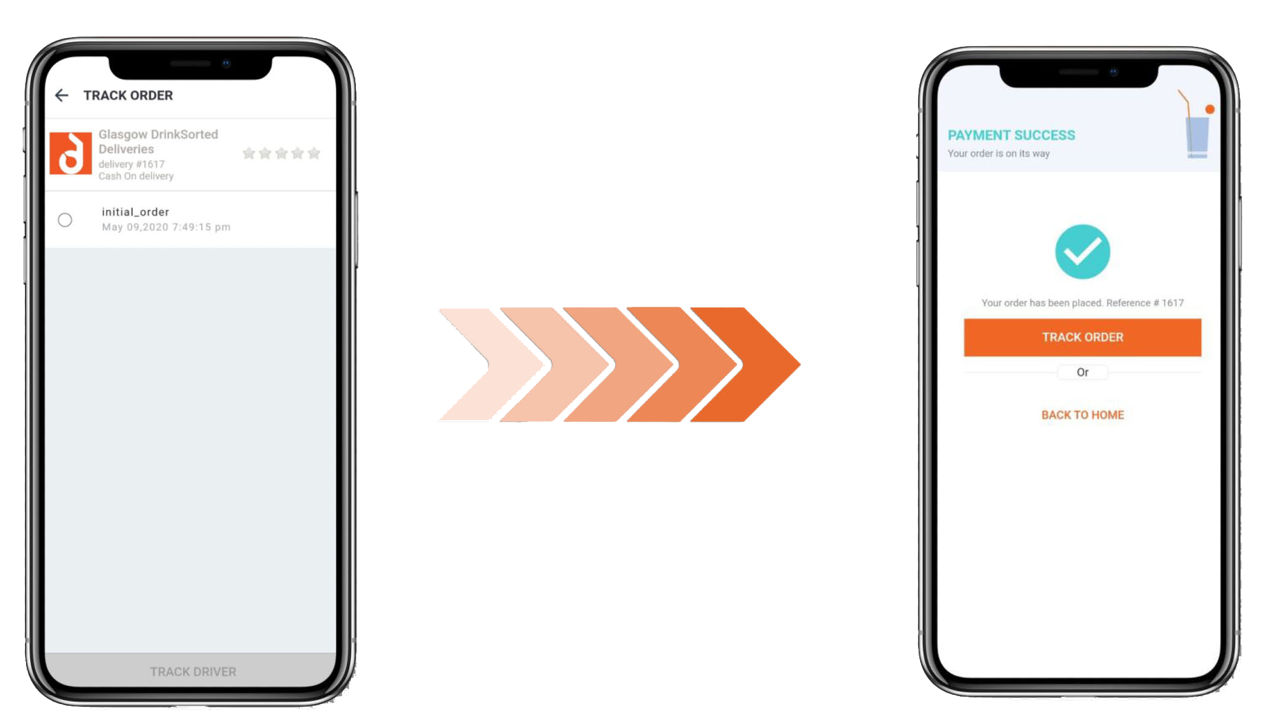
DRIVER
APP
CONSUMER TRACKS THE ORDER VIA INBUILT GPS RIGHT TO THE DOOR WITHIN 60 MINUTES
MERCHANT
APP
DRIVER
APP
DELIVERY
APP
ORDER
IS PLACED
DRIVER STARTS ORDER UNTIL
COMPLETION & IS GPS TRACKED
ACCEPT THE ORDER AND
ASSIGN A DRIVER IN 3 TOUCHES
DRIVER SELECT
ASSIGNED ORDERS

Slide 6

HOW DO I SIGN UP ?
Provide key
information to
DrinkSorted / UWS BDM
We’ll reach out
shortly to
finalise details
and send a
contract
Sign the contract
and choose your
menu items
Just download the App and You’ll be ready
to sell straight
away!
You can make any changes to online store, menu, pricing at any time you want via the app

Slide 7
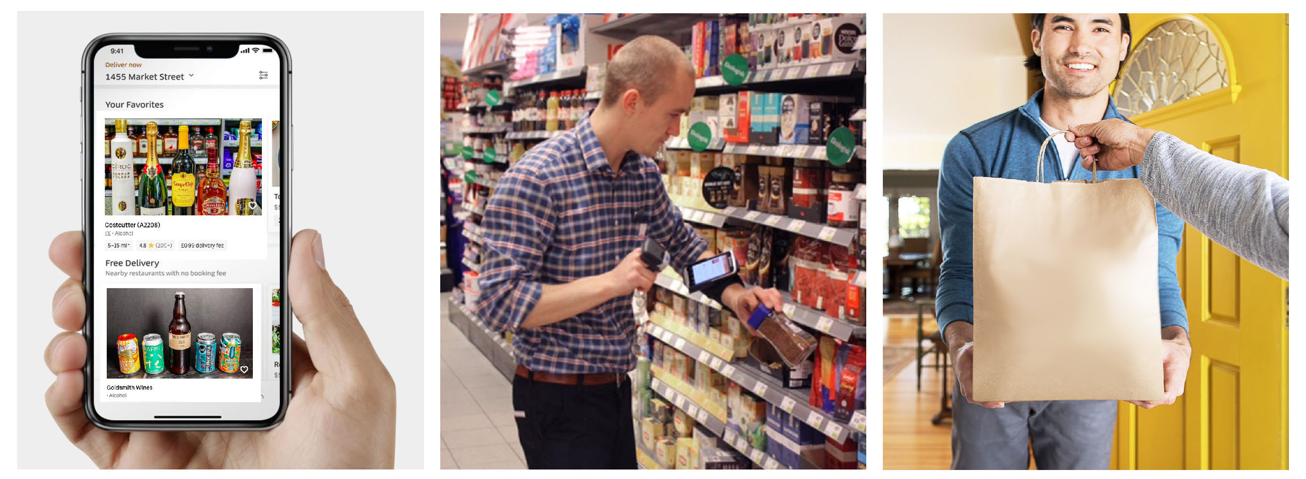



Please contact your local
BDM to get involved.

